Slide 1

CAL-ZONE nutrition app
Notes:
phat

Slide 2
Team introduction
Phat Huynh – Project manager
Nathan Dessi – Database, Back end and Front end
Dexter Pressley – Full Stack
Daniel DuVall – Front End
Daylen Hendricks – API
Mattias Ruiz – Mobile development
Savion Gay – Front end
Notes:
Everyone

Slide 3

Technology used
GitHub: source control, pull requests, and issue tracking
DigitalOcean: remote hosting for the web app/API with a public domain + HTTPS
MongoDB Atlas: cloud database for storing users, items, and app data
Postman: test and document API requests/responses before wiring up the UI
Online Gantt: plan milestones, owners, and timelines at a glance
Flutter (mobile): build the mobile app and demo on a physical phone
Figma: UI/UX design, component library, and handoff specs
Claude: AI assistant to brainstorm features, refine wording, and review code or docs
SwaggerHub: design, version, and share Open API specs for the backend API
Mermaid: generate quick UML/sequence diagrams from text for architecture and flows
Notes:
phat

Slide 4
Things that went well
Quick Database and backend setup
Weekly team meetings
Quick app development from flutter
Website design quickly agreed upon
Notes:
Database- Nathan
Week and quickly agree- phat
App - matt

Slide 5
Things that did not go well
Lighthouse score challenges
Front-end implementation delays
Some APIs took longer than expected
Problems with node mailer (SendGrid)
GitHub went down
Notes:
Lighthouse- danial
Fornt end – savion
Api delay and problem – Daylen
Github – dexter

Slide 6
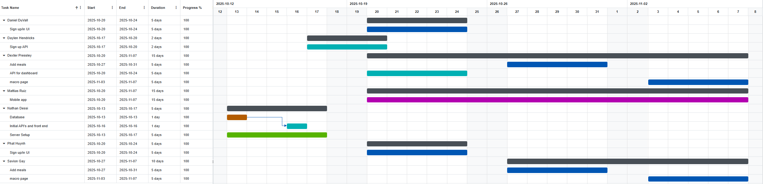
Gannt Chart
Notes:
Phat

Slide 7
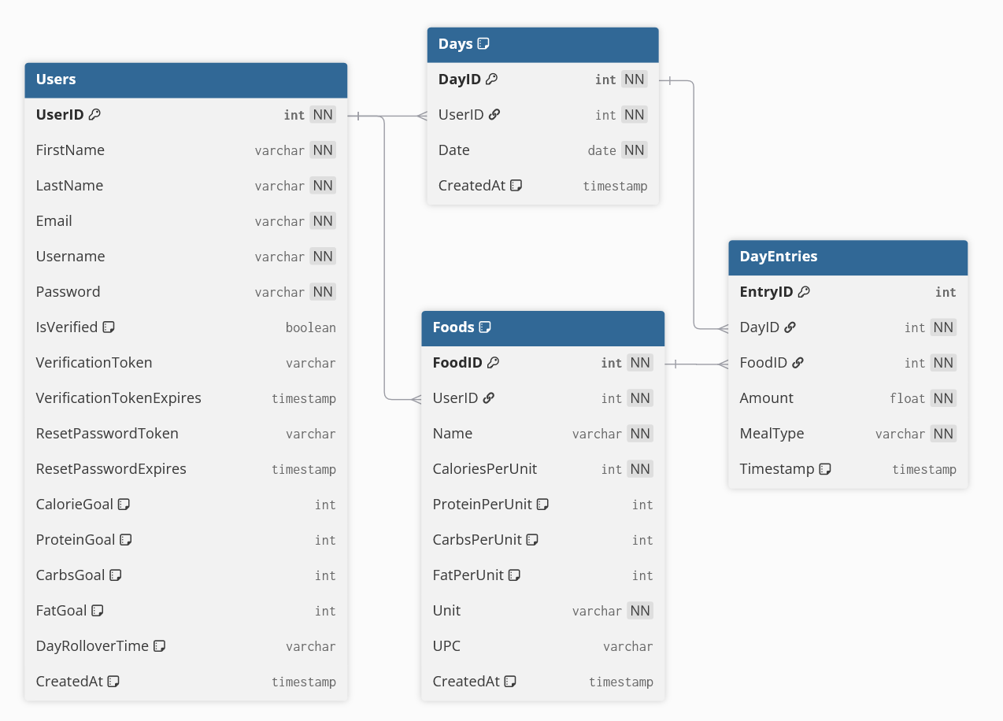
Entity relation diagram
Notes:
Nathan

Slide 8
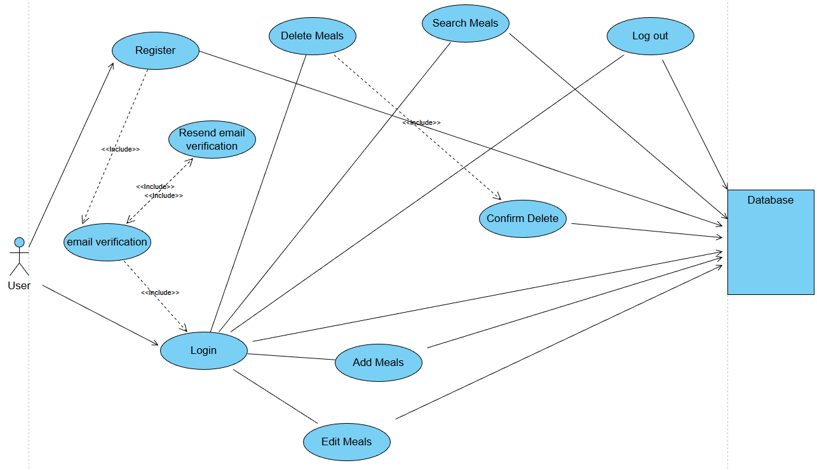
Use Case diagram
Notes:
phat

Slide 9
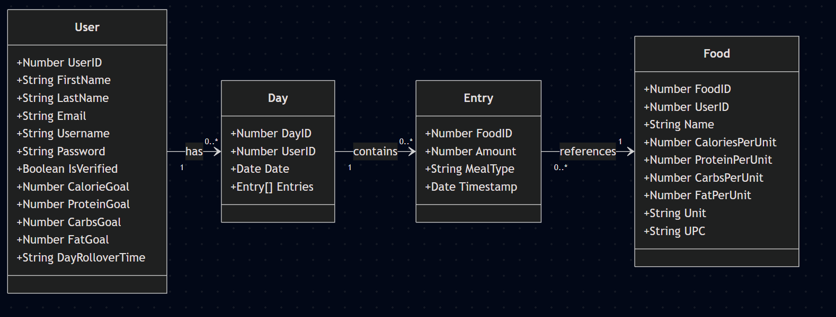
Class diagram
Notes:
This is our class diagram for the backend of our nutrition app.
At the center we have the User class. A User stores basic account information like FirstName, LastName, Email, and Username, along with security-related fields like Password and IsVerified for email verification. We also store the user’s nutrition goals here: CalorieGoal, ProteinGoal, CarbsGoal, FatGoal, and a DayRolloverTime, which lets each user define when their tracking day resets.
Each User can have zero or many Day objects. A Day represents one tracking day for that user. It has a Date, a DayID, and an array of Entries. So you can think of Day as the container for everything the user ate on that date.Inside each Day, we have zero or many Entry objects. An Entry represents a single food item logged by the user. It stores which food was eaten (FoodID), the Amount, what MealType it belongs to—like breakfast, lunch, or dinner—and a Timestamp for when it was added.
Finally, each Entry references exactly one Food. The Food class stores the reusable nutrition data: Name, Unit, and the calories and macros per unit—CaloriesPerUnit, ProteinPerUnit, CarbsPerUnit, and FatPerUnit. We also support barcodes with the UPC field, which we use for the scanner feature.
Putting it together: one User has many Days, each Day has many Entries, and each Entry points to a Food item. This structure lets us reuse food definitions across multiple entries, and it makes it easy to compute daily totals and compare them against the user’s goals.”
If he ask about upc, say it could be used for SD1

Slide 10
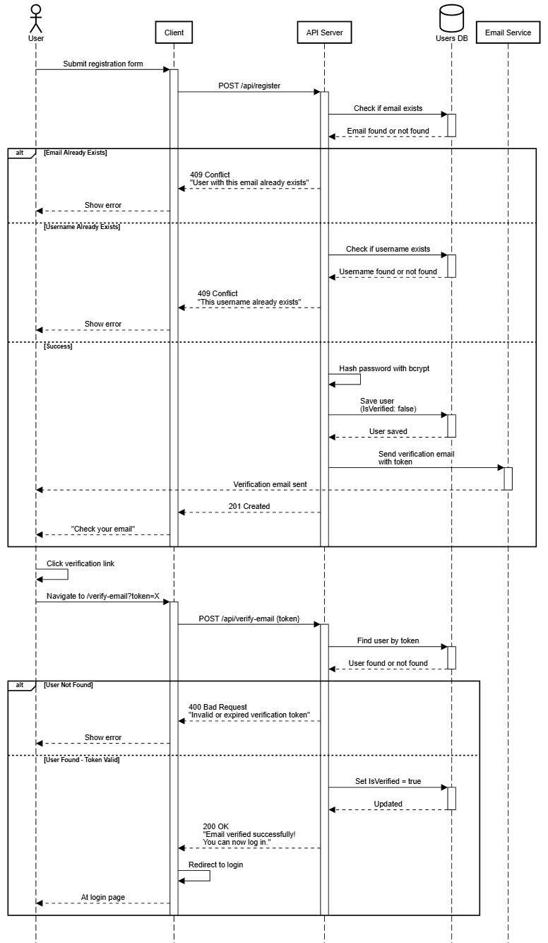
Sequence Diagram
Notes:
Daylen

Slide 11
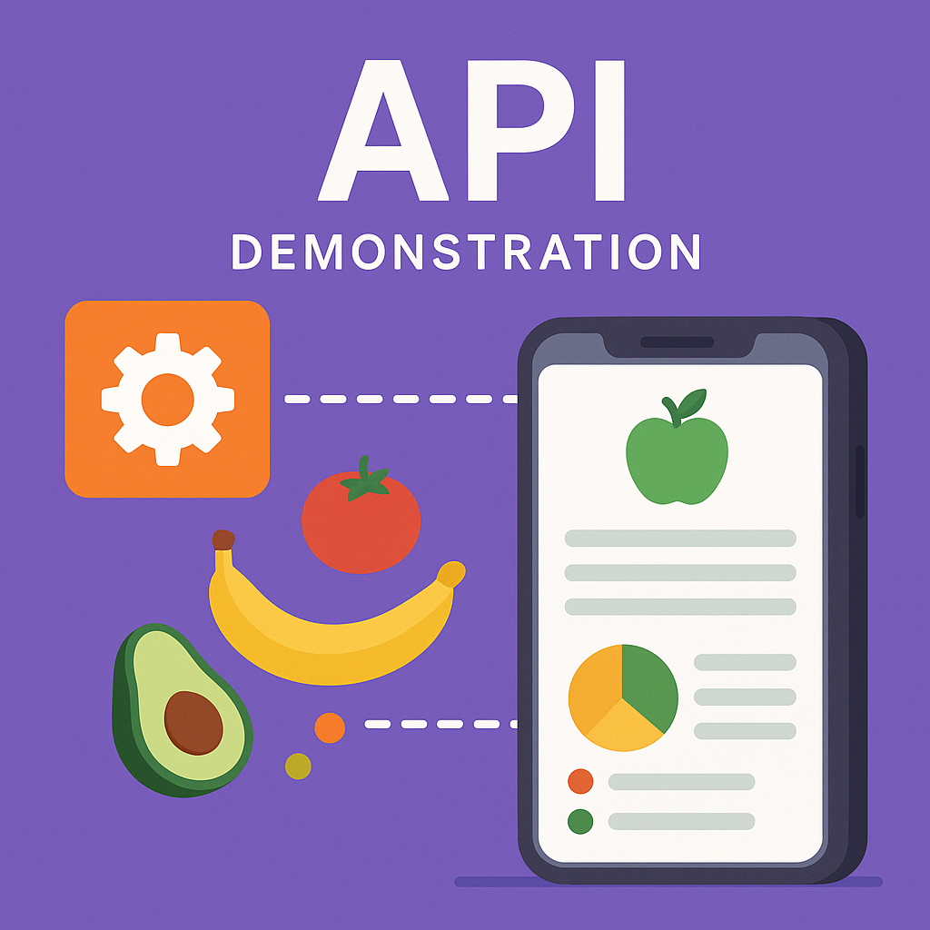
CalZone API Documentation
Notes:
Dexter

Slide 12
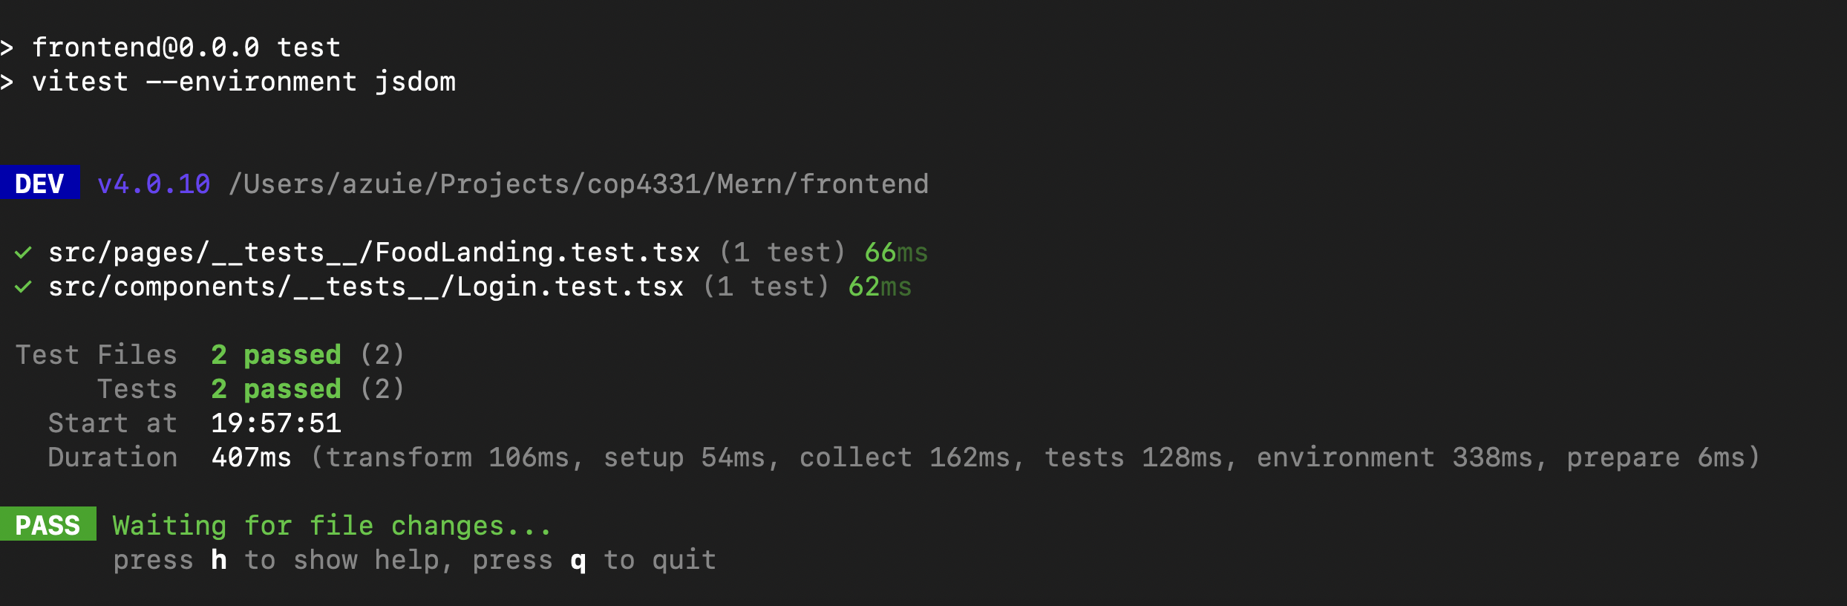
Unit (login) and integration (food landing) test
Notes:
nathan

Slide 13

APP Demonstration
frontend
Notes:
Matt and savion

Slide 14
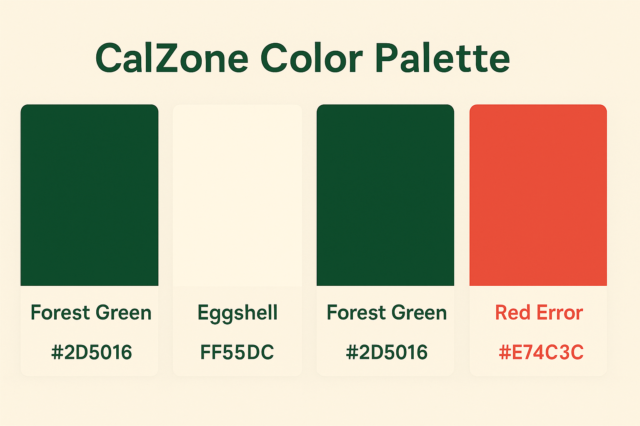
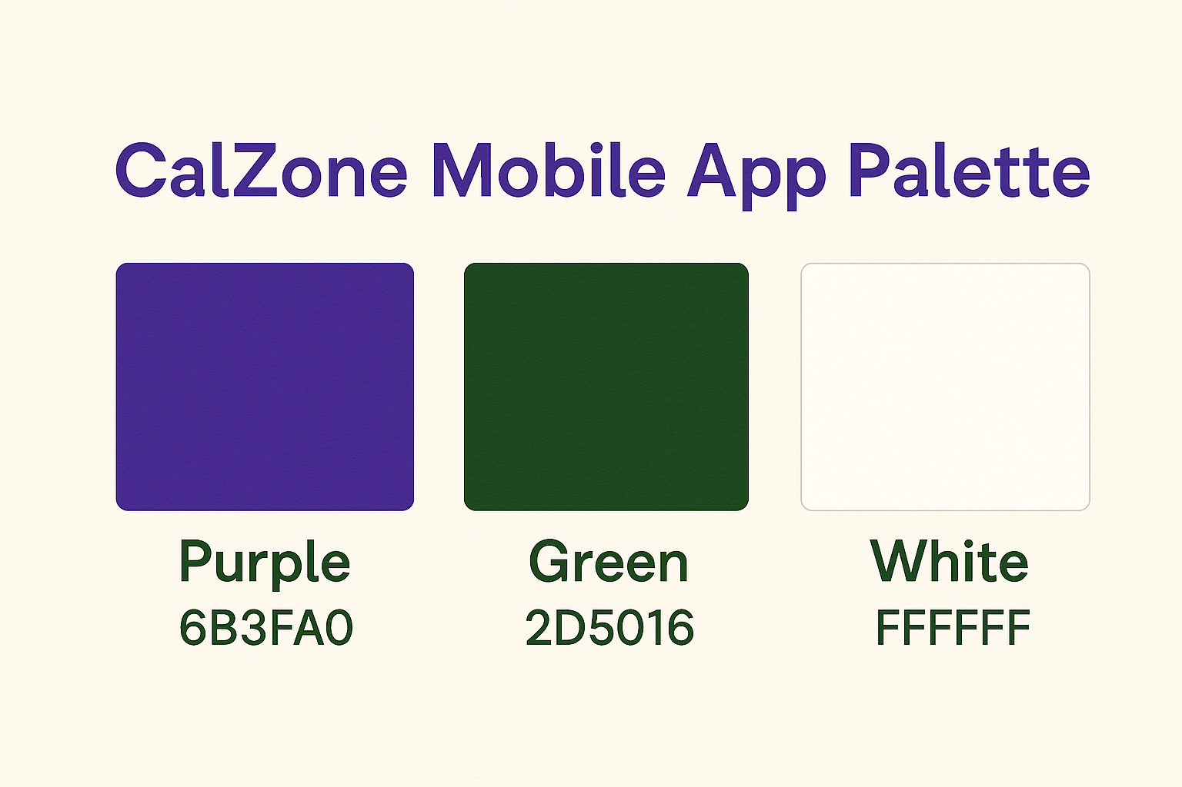
Color pallet
Notes:
Danial

Slide 15
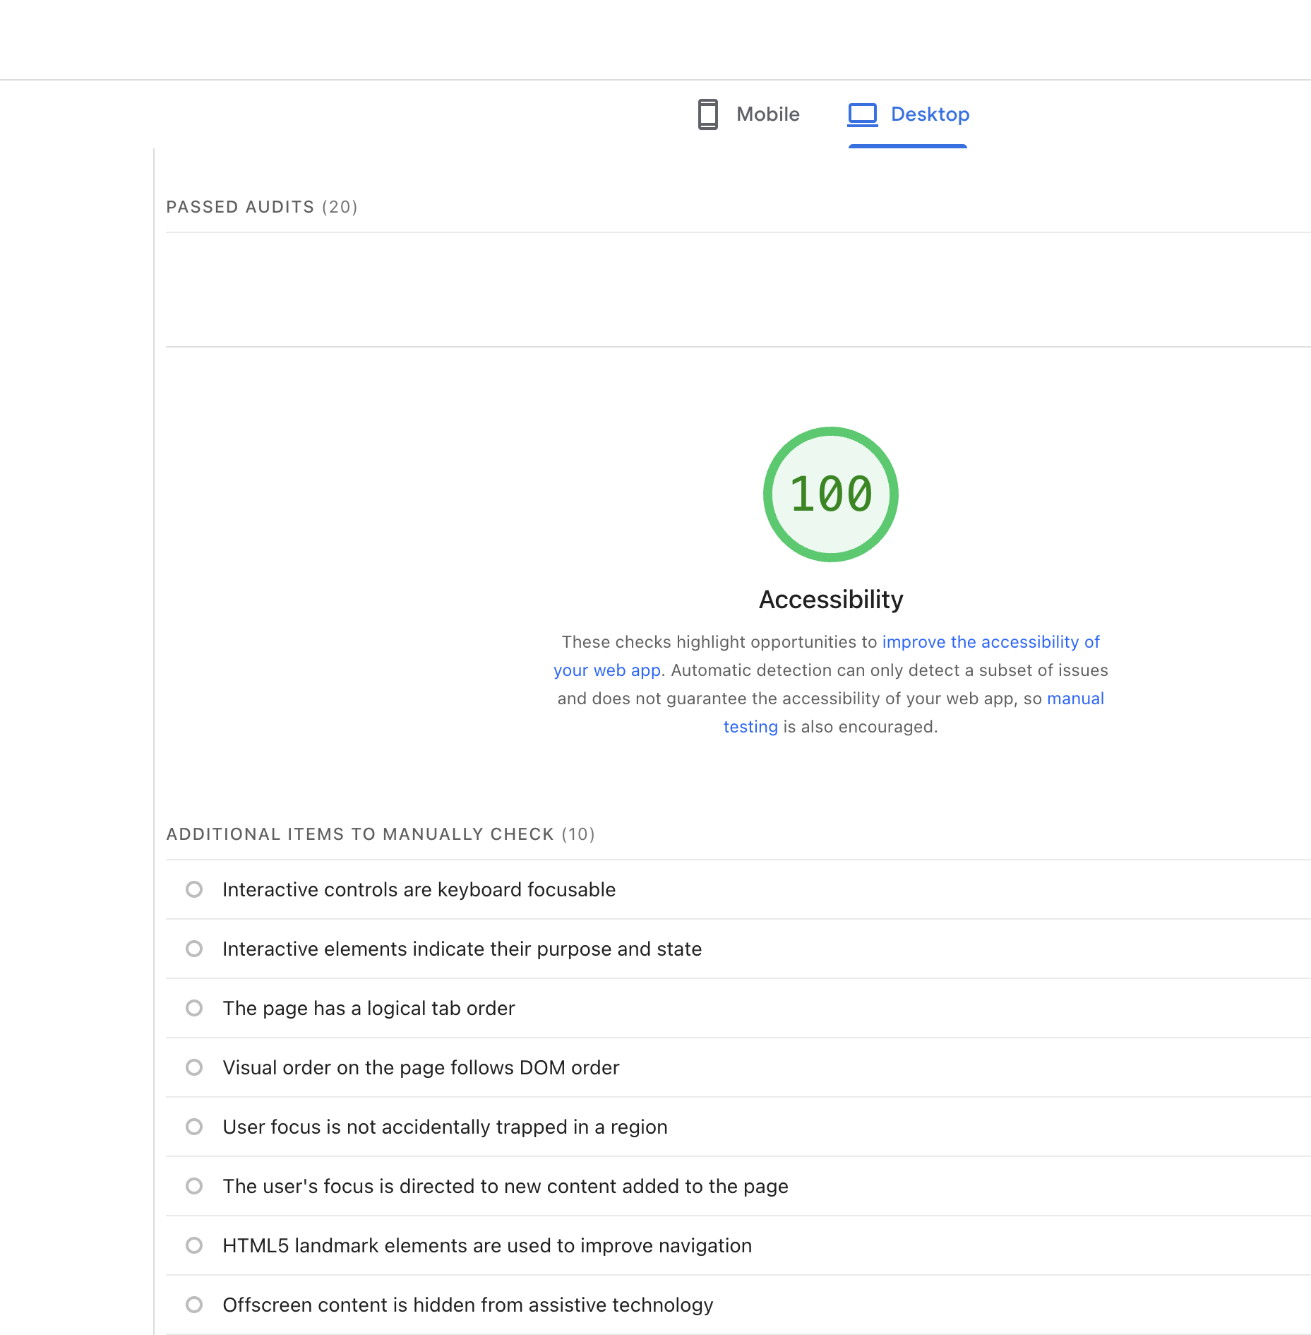
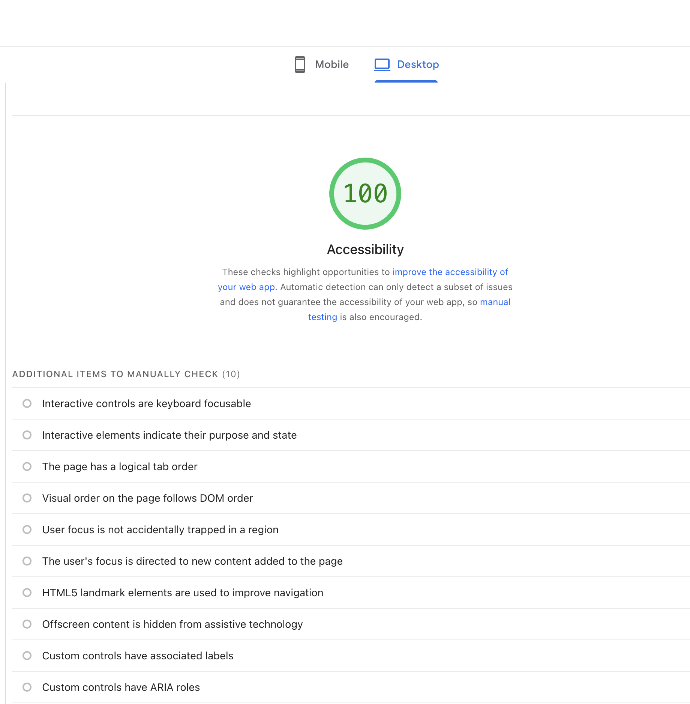
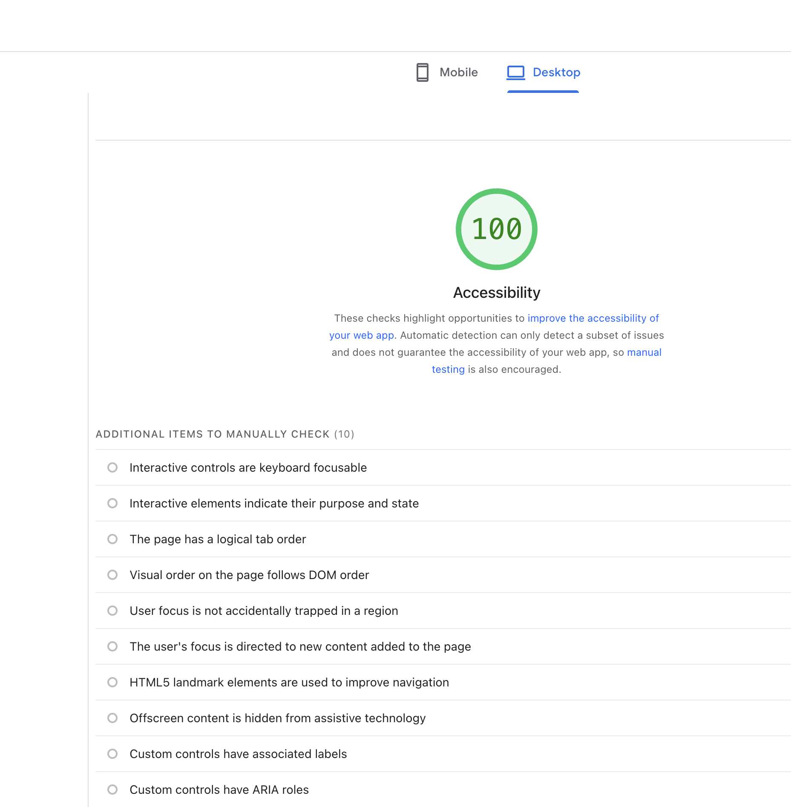
Lighthouse accessibility
Perfect score on login, sign up and landing page
Notes:
Danial

Slide 16

Question time
Notes:
phat

